Slide 1

Predicting Academic Outcome in Higher Education
Arthur Behesnilian | Lisa Liu | Isidoro Flores Osvaldo Valdiviezo | Kenia Sanchez-Macario

Slide 2
Table of contents
01
02
03
Data Visualization/ Exploration
Modeling
Final Results

Slide 3

Project Detail and Goals
Using the Kaggle Playground Series S4E6 dataset, build a predictive model that classifies students into three categories based on their academic trajectory:
Graduate
Dropout
Enrolled

Slide 4

01
Data Visualization/Exploration

Slide 5
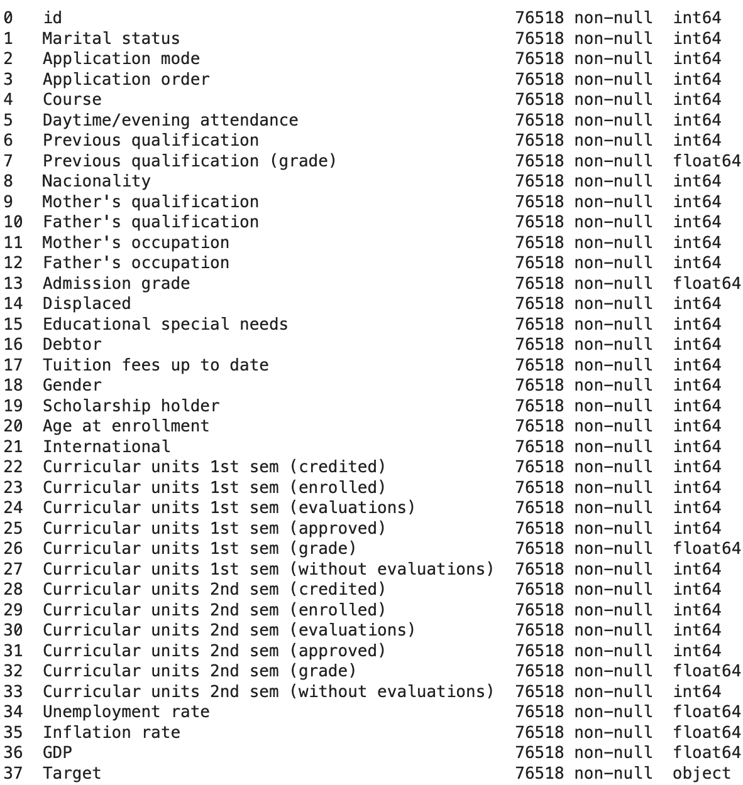
Dataset Overview: Predicting Student Success
The data being explored was collected by a University in Portugal and contains 4,424 students with 37 features for each student which include:
Academic background
Socio-Economic factors
Demographic information
Outcome

Slide 6
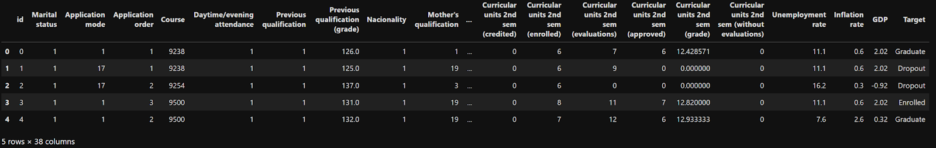
Steps taken to Explore Data
The first step we took to explore the data was visualizing the structure to determine how many features we were working with and what those features were.

Slide 7
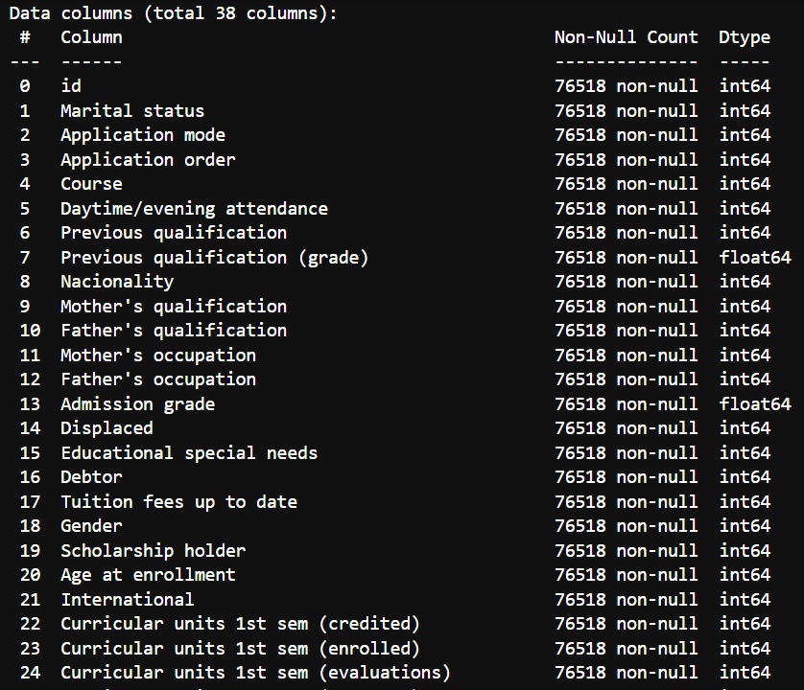
Steps taken to Explore Data
We then checked to see if the data is clean with no missing (null) values, which it was.
This made analyzing the data easier for us.

Slide 8
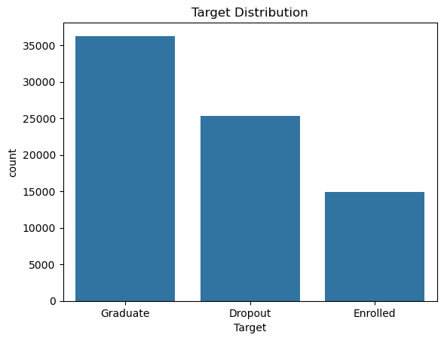
Steps taken to Explore Data
We visualized our target distribution and discovered a problem of class imbalance.
To solve this issue, we used stratified train-test splits and class weights during model training to ensure higher accuracy of results.

Slide 9
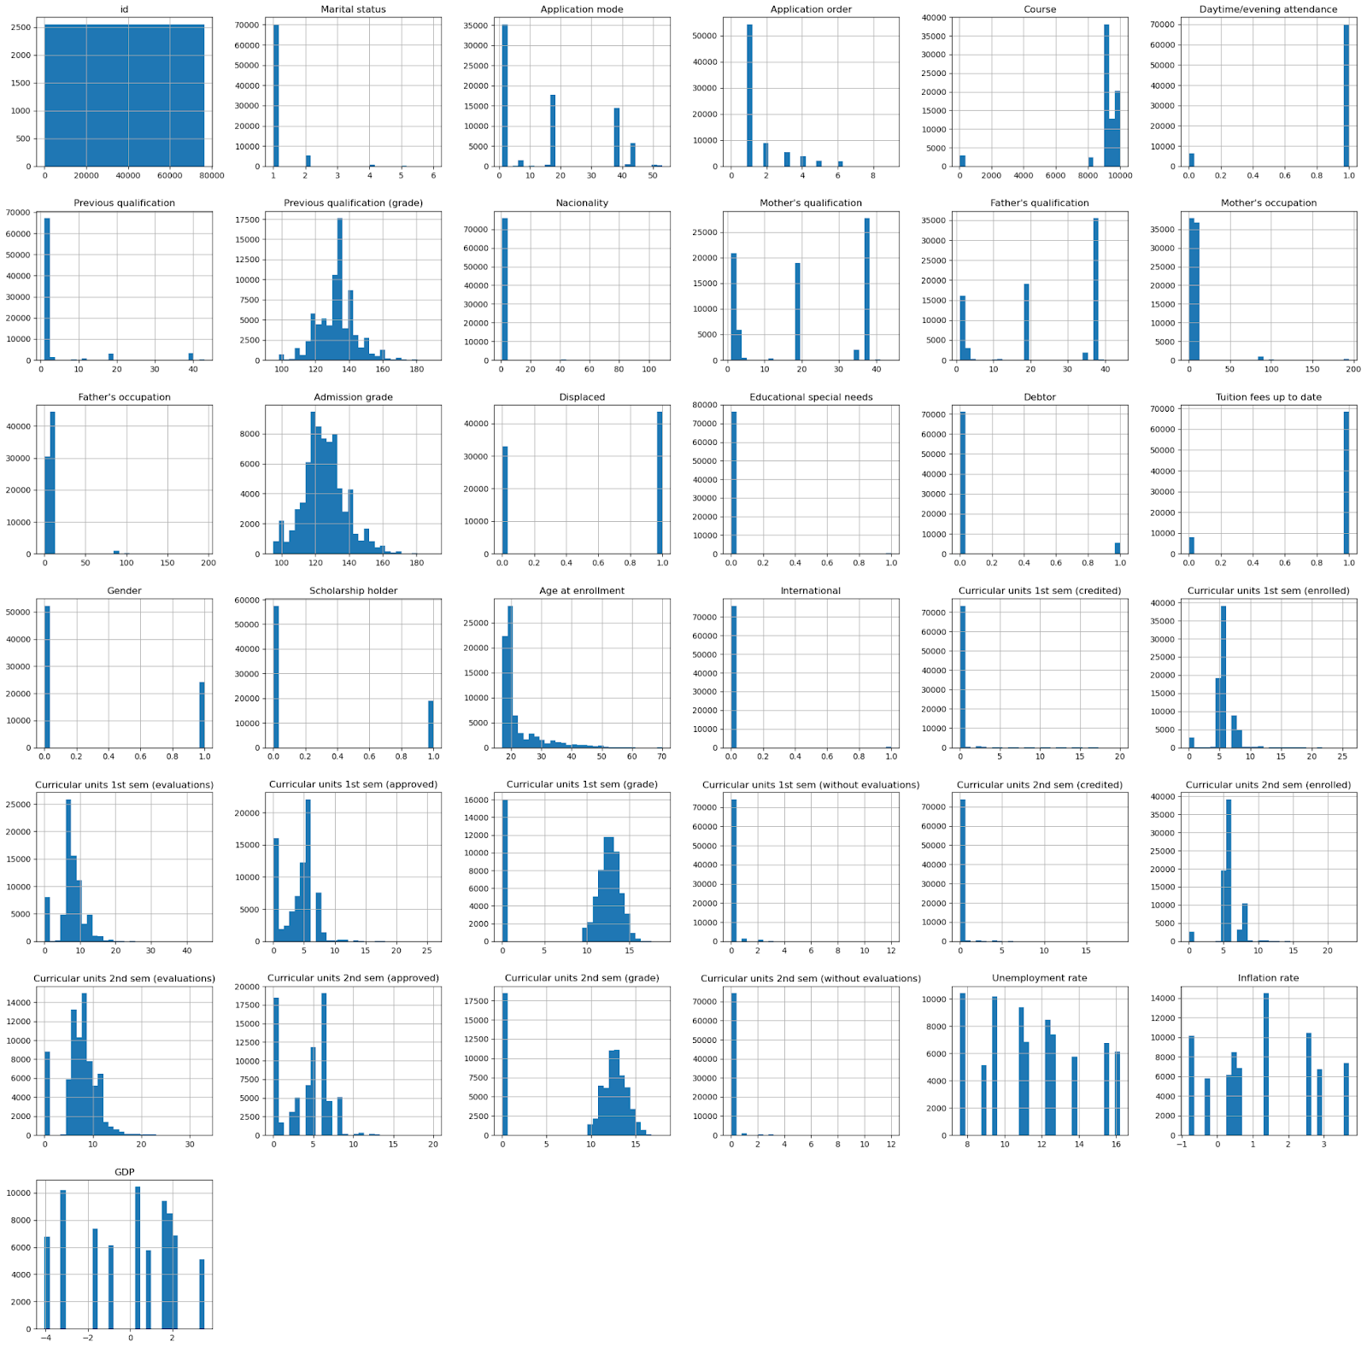
Steps taken to Explore Data
We visualized our feature distribution and extracted a few insights from the data:
Age at enrollment is right-skewed.
Grade features follow roughly normal distributions.
Binary features are heavily skewed toward 0.
Curricular unit features show varied distributions reflecting performance levels.

Slide 10
02
Modeling

Slide 11
Preprocessing Pipeline
Using scikit-learn's ColumnTransformer to handle different feature types:
Numerical Features:
Imputation using median values
Standardization using StandardScaler
Categorical Features:
Imputation using the most frequent value
One-hot encoding with unknown category handling

Slide 12
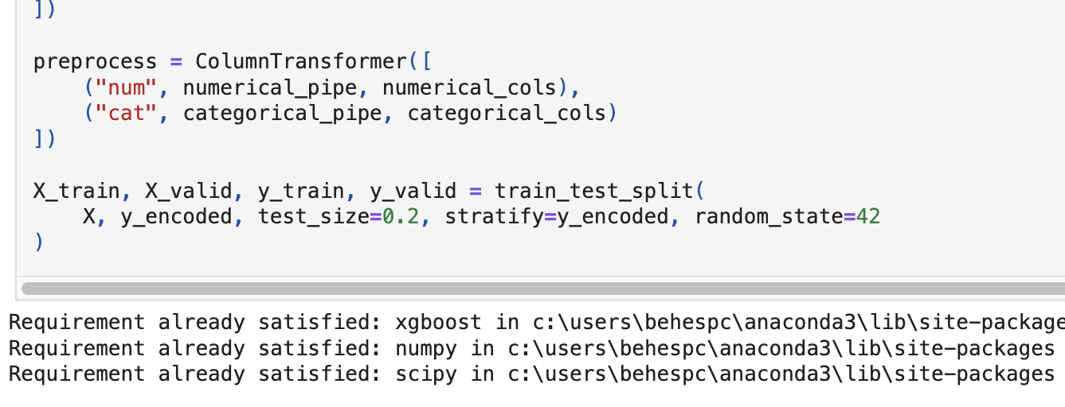
Train Validation Split
We use an 80-20 train validation split so our models can learn from most data while still having sufficient data to validate our model training.
Our data is imbalanced, as a result, we applied stratified sampling.
This helps us obtain a more reliable measurement of model performance.

Slide 13
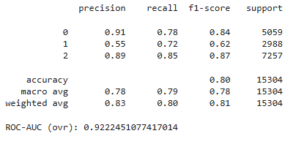
Models | Logistic Regression
Logistic Regression (Baseline): Linear model with balanced class weights. Provides interpretable baseline performance.

Slide 14

Models | Random Forest & XGBoost
Random Forest: Ensemble of 300 decision trees with balanced class weights. Captures non-linear relationships.
XGBoost: Gradient boosting with 500 estimators, learning rate of 0.05, max depth of 6.
As we can see, from the three classification algorithms, we evaluated, XGBoost seems to be the best

Slide 15
03
Final Results

Slide 16
Results
We successfully built a machine learning pipeline to predict academic risk for higher education students.
Our XGBoost model achieved
83% accuracy and 0.936 ROC-AUC effectively distinguishing between students who will graduate, drop out, or remain enrolled
The "Enrolled" class was hardest to predict since those students could go either way - some will drop out and some will graduate.
All models got above 0.92 AUC which means the features are pretty useful for predicting outcomes.

Slide 17
Responsibilities
Arthur Behesnilian | Lisa Liu | Isidoro Flores | Osvaldo Valdiviezo | Kenia Sanchez-Macario
Data Analysis, Model Training, Documentation | Documentation, Presentation, Peer Review | Data Analysis, Documentation, Presentation | Model Training, Documentation, Peer Review | Documentation, Presentation, Peer Review

Slide 18

Thanks!

Slide 19
References
Kaggle Playground Series S4E6:
https://www.kaggle.com/competitions/playground-series-s4e6
scikit-learn documentation:
https://scikit-learn.org
XGBoost documentation:
https://xgboost.readthedocs.io

